Slide 1
Secure Web Hosting with HTTPS on Microsoft Azure
Suresh Kumar D, Vimalesh C, Rama Krishnan A, Yogesh Balaji K UG Scholars Anjali S – Assistant Professor Lavanya T – Lecturer Gojan School of Business and Technology, Redhills, Tamil Nadu, India – 600052

Slide 2
Abstract
In the digital era, ensuring secure and reliable web hosting is essential for protecting sensitive user data and building trust. This project presents a comprehensive solution for secure web application deployment using Microsoft Azure, with a focus on enabling HTTPS through Azure Managed Certificates, ensuring automated SSL/TLS encryption and renewal. To enhance protection against cyber threats, we integrate Azure Web Application Firewall (WAF) and DDoS Protection, which defend against malicious traffic and attacks. Additionally, Azure Front Door is implemented to provide global load balancing, faster content delivery, and optimized traffic routing, improving both security and performance. This cloud-based approach reduces manual configuration, supports compliance with modern security standards, and delivers a scalable, automated, and secure web hosting environment suitable for real-world applications.

Slide 3
Introduction
The escalating frequency and sophistication of cyber threats targeting web applications necessitate a proactive and robust approach to security and infrastructure. Secure communication is no longer optional but a fundamental requirement for maintaining user confidence and protecting sensitive information. HTTPS, employing SSL/TLS encryption, has become the universally accepted standard for ensuring the confidentiality and integrity of data exchanged between users and web servers. Microsoft Azure provides a comprehensive and versatile platform for deploying and managing secure websites, offering a rich ecosystem of integrated tools designed for encryption, continuous monitoring, and proactive threat mitigation. This project delves into the practical implementation of hosting web applications on Azure with a strong emphasis on security, demonstrating how to effectively utilize its built-in capabilities for encryption, performance optimization, and robust defense mechanisms

Slide 4
Objective
To architect and deploy a secure and scalable web hosting environment utilizing the Microsoft Azure platform.
To seamlessly enable HTTPS for the hosted web application by leveraging Azure’s Managed SSL certificates, ensuring automatic renewal and simplified management.
To fortify the application’s security posture through the strategic implementation of Azure Web Application Firewall (WAF) to mitigate application-layer vulnerabilities and DDoS Protection to defend against volumetric denial-of-service attacks.
To optimize the web application’s global accessibility and performance by strategically employing Azure Front Door for intelligent traffic routing and enhanced content delivery.

Slide 5
Literature Survey/Existing System
Conventional web hosting solutions often present limitations in terms of automated security management, particularly concerning the deployment and ongoing maintenance of SSL/TLS certificates, which frequently require manual intervention and can be prone to oversight. Prior academic and industry research consistently highlights the potential of cloud platforms like Azure to significantly enhance web application security when configured and managed effectively. However, many existing implementations may lack comprehensive automation in security protocols and real-time threat response capabilities, potentially leaving applications vulnerable to emerging cyber threats. Our proposed approach aims to address these identified gaps by deeply integrating automated HTTPS provisioning and renewal, intelligent traffic routing for enhanced security posture, and proactive multi-layered protection mechanisms directly within the Azure ecosystem, offering a more streamlined and resilient solution compared to traditional methods.

Slide 6
Proposed Methodology
Our methodology employs a layered approach to establish a secure and high-performing web hosting environment on Azure:
Hosting Layer: The web application is deployed on Azure App Service, a fully managed Infrastructure-as-a-service (IaaS) offering scalability and reliability.
Security Layer: Secure communication is enforced by enabling HTTPS using Azure Managed Certificates, which provides free SSL/TLS certificates that are automatically provisioned and renewed, simplifying the management overhead.
Protection Layer: To safeguard the application from malicious attacks, Azure Web Application Firewall (WAF) is implemented to filter HTTP/HTTPS traffic and protect against common web exploits. Additionally, Azure DDoS Protection is configured to mitigate large-scale denial-of-service attacks that could impact application availability.
Performance Layer: Azure Front Door, a global, scalable entry point, is utilized to intelligently route user requests to the nearest available App Service instance, optimizing response times and improving overall user experience.

Slide 7
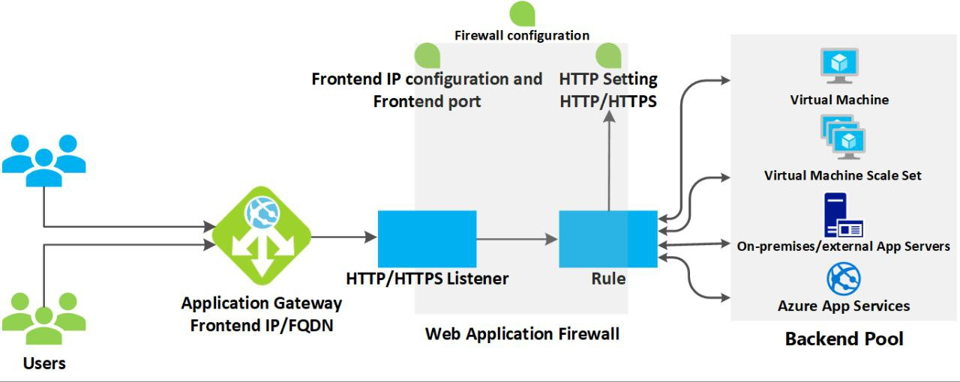
Proposed Architecture Diagram

Slide 8
Findings/Results
The web application was successfully provisioned and is now securely accessible via HTTPS, confirming the successful deployment of the hosting environment on Azure App Service.
The integration of Azure Managed Certificates has been verified, with SSL/TLS certificates automatically issued and the successful logging of automated renewal processes, demonstrating the ease of maintaining secure connections.
Through rigorous testing using simulated attack vectors, including common web vulnerabilities such as SQL injection and Cross-Site Scripting (XSS), the configured Azure WAF policy effectively identified and blocked malicious requests, validating its role in protecting the application layer.
The implementation of Azure Front Door resulted in a noticeable reduction in page loading times and a significant improvement in overall access times for users across different geographical regions, showcasing its effectiveness in optimizing global application delivery

Slide 9
Conclusion
In conclusion, this project successfully demonstrates the creation of a robust cloud-based web hosting architecture on Microsoft Azure that prioritizes security, operational automation, and optimal performance. By strategically integrating Azure’s comprehensive suite of services, including App Service for hosting, Managed SSL for simplified HTTPS, WAF and DDoS Protection for layered security, and Front Door for enhanced global delivery, the resulting solution offers a reliable, fast, and secure platform for serving web content. This approach effectively addresses common vulnerabilities and complexities associated with conventional hosting environments and presents a scalable and adaptable model for real-world, production-grade web applications.

Slide 10
References
T. Sheela et al., “Secure Online Examination System on Azure Cloud,” IEEE ICCCT 2021.
T. Benjaponpitak et al., “Containerized App Migration Across Clouds,” IEEE INFOCOM 2020.
Q. Jacquemart et al., “DNS Data for Cloud Deployment Analysis,” IEEE TMA 2019.
Microsoft Azure Official Documentation (App Service, Front Door, SSL/TLS, WAF)

Slide 11
THANK YOU

